Slide 1
Proposed Patient Flow Plan & Renovation Schedule
Presenter: Nazira Rasol
Presented to: National Health Hospital
4 March 2022

Slide 2
TABLE OF CONTENTS
01.
Background
02.
Exploratory Data Analysis
03.
Allocating Resources
04.
Renovation Schedule
Purpose
Outcome
Proposal
Patient Flow
Bed capacity
Consultation Rooms
Manpower Allocation
Identifying High Traffic
Recommendations on Reducing Interruption

Slide 3
1. Background
There is proposed to be some renovation works in the Accident & Emergency section of the hospital. The dataset consists of DEM admissions of 354 patients from 19 January 2015 (Monday) to 25 January 2015 (Sunday).
Outcome of Renovation:
Provide infrastructure sufficient to support the patient load
Provide least disruption to A&E services
Propose:
How many P1 Critical Care Intensive Treatment Area beds
How many P2 Critical Care Area beds
How many P3/P4 doctor consultation rooms will be required after the renovation works,
And any other recommendations necessary.

Slide 4
Background - Patient Flow
Registration
Areas of Analysis
Critical Care Intensive Treatment (CCIT)
Operation Theatre
Inpatient Wards
Discharge
P1
Ambulance
OR
Walk-in
P2
Critical Care Area
Operation Theatre (if necessary)
Emergency Observation Ward
Inpatient Wards
Go for tests (if necessary)
Pharmacy & Cashier
P3
Ticket Number
Discharge
Observation Bay
(Within Critical Care Area)
P4
Consult GP
Emergency Observation Ward
Inpatient Wards

Slide 5
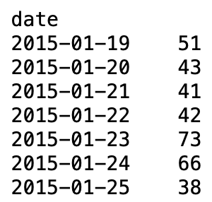
2. Exploratory Data Analysis
Number of Patient Admits Per Day
Based on patient load alone (disregarding Triage Category)
2 busiest days are Fridays and Saturdays.
2 least busiest days would be Sundays and Wednesdays.
Assumption and Considerations:
Patients coming from ambulance and walk-in will have no distinction (as data is not given).
Pattern is the same every single week.

Slide 6
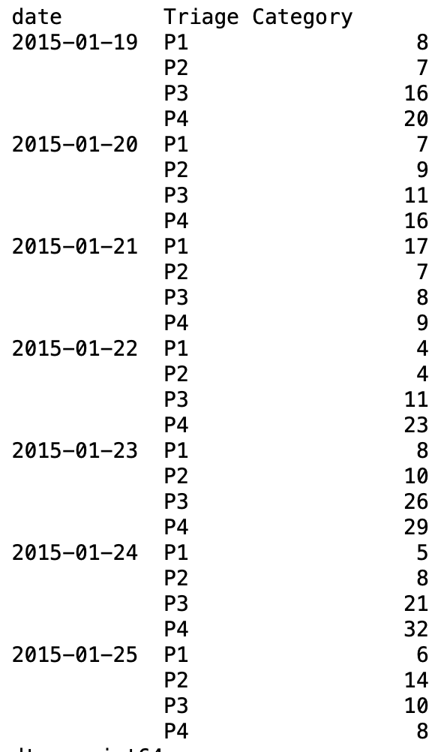
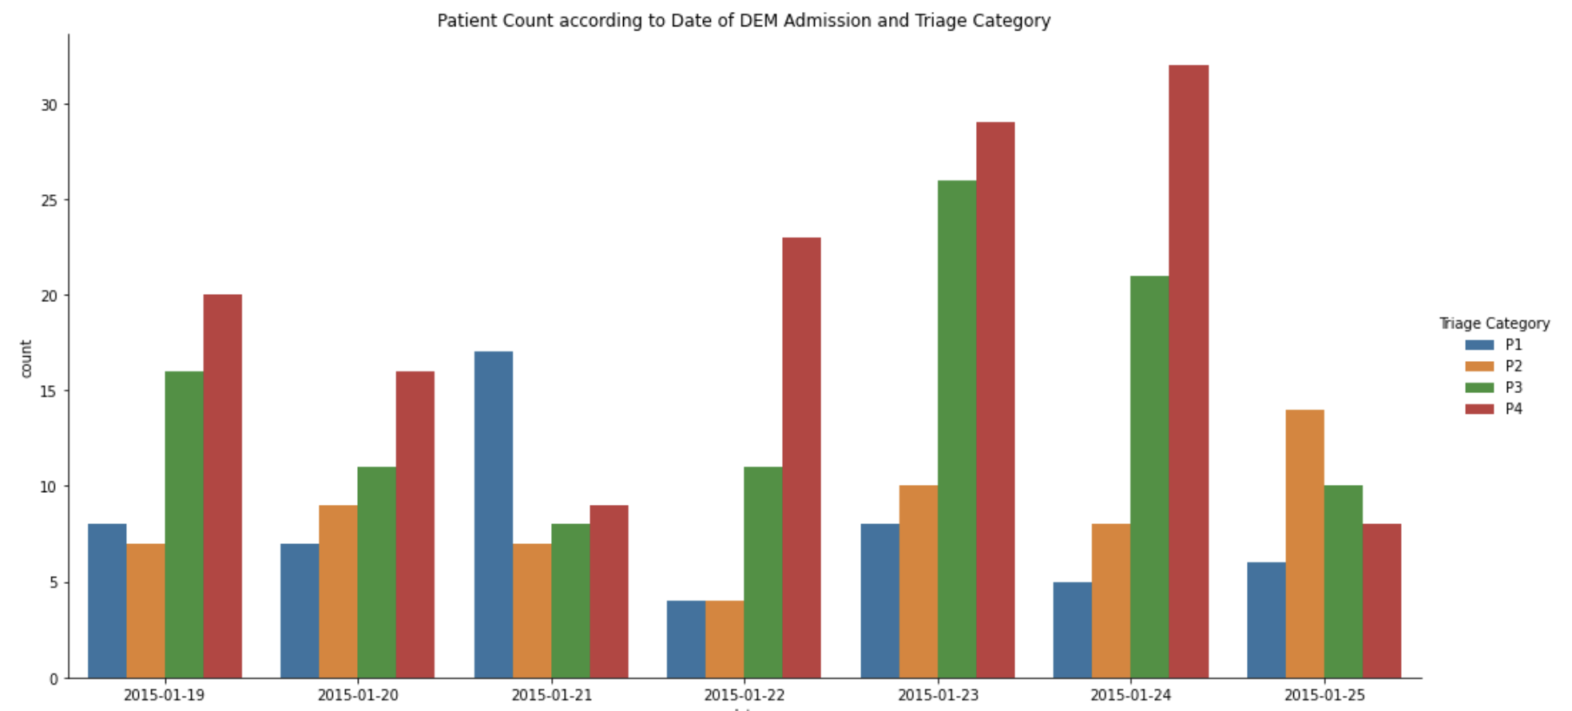
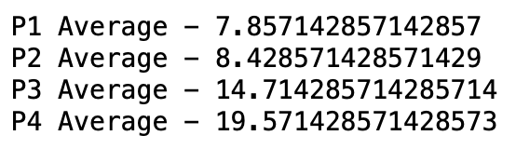
Number of Patient Admits Per Day (Based on Triage Category)
For P1, there is a spike on Wednesday which might be unexpected.
For P2, the busiest day is on Sunday.
For P3, the busiest day is on Friday.
For P4, the busiest day is on Saturday.

Slide 7
3. Allocating Resources
This is the current manpower capacity of National Health Hospital:
Total of 10 doctors and 40 nurses.
Every 2 Critical Care Intensive Treatment beds or part thereof can be managed by 1 doctor and 4 nurses.
Every 4 Critical Care Area beds or part thereof can be managed by 1 doctor and 3 nurses.
Each P3/P4 doctor consultation room requires 1 doctor and 2 nurses to operate.
When do our doctors and nurses work?
A&E doctors and nurses work 3 shifts – 7am to 3pm; 3pm to 11pm; 11pm to 7am.
There are 10 doctors and 40 nurses.

Slide 8
Taking Time into Consideration
When are patients admitted?
A&E is operational 7 hours a week, 24 hours a day.
A P1 patient will usually occupy a Critical Care Intensive Treatment Area bed for 1 hour.
A P2 patient will usually occupy a Critical Care Area bed for 2 hour.
A P3/P4 patient will usually spend 30 min in the doctor consultation room.

Slide 9
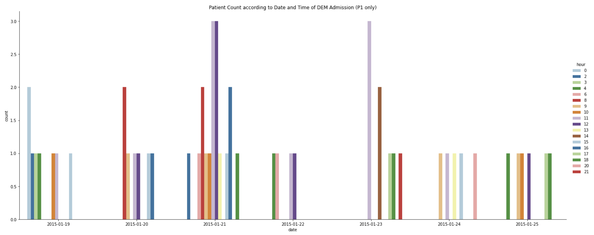
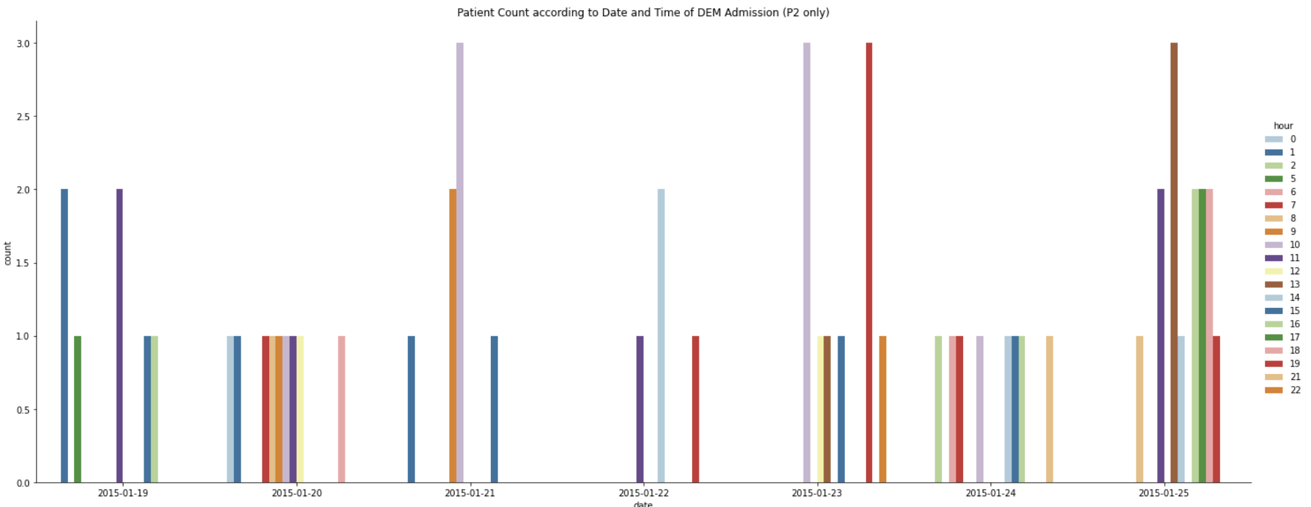
For P1
The highest number of CCIT beds occupied per hour is 3.
However, it is recommended to have 50% more in order to anticipate increase in patient load or delayed discharge i.e. 6 CCIT beds.
For P2
The highest number of beds being occupied during any one-hour block is 5.
However, it is recommended to have 50% more in order to anticipate increase in patient load or delayed discharge i.e. 10 CCA beds.

Slide 10
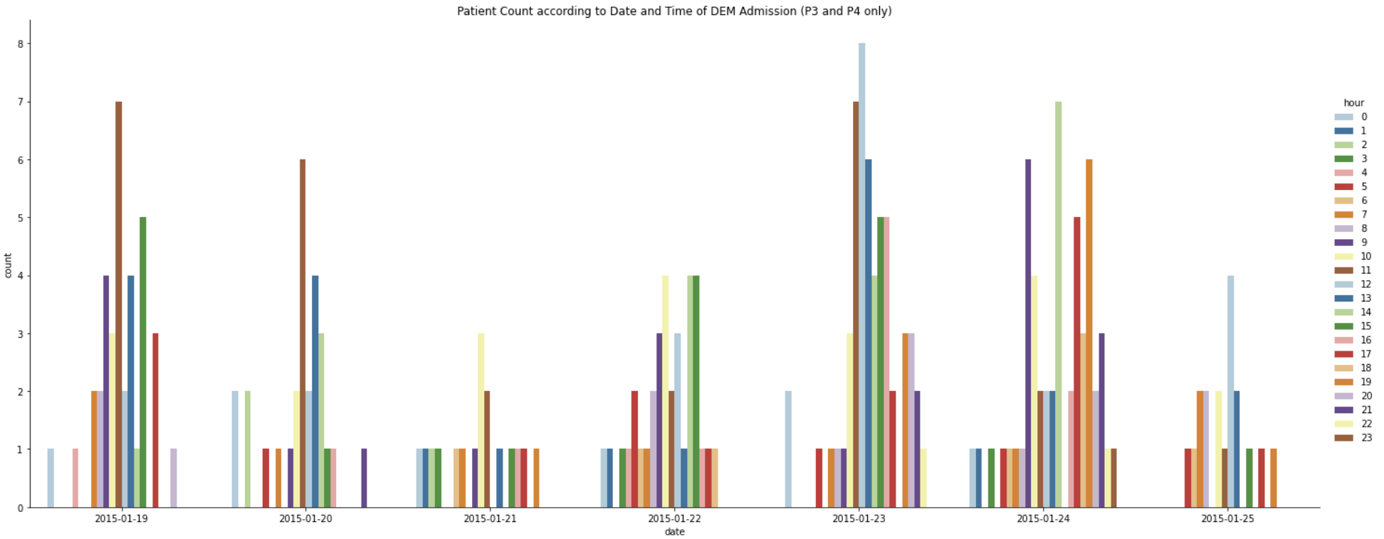
For P3/P4
The highest number of P3/P4 patients at any hour is 8, occuring at 12pm on Friday. Hence, there should be 4 consultation rooms to accommodate the maximum.

Slide 11
Manpower Allocation per Day (Friday)
Shift | P1 2 patients : 1 doctor : 4 nurses 1 hour per patient | P2 4 patients : 1 doctor : 3 nurses 2 hours per patient | P3/P4 1 patient/room : 1 doctor : 2 nurses 30 minutes per patient
7am to 3pm | (3 patients) Peak: 2 doctors, 8 nurses Non-peak: 1 doctor, 4 nurses | (3 patients) 1 doctor 3 nurses | (8 patients) Peak: 1 doctors, 2 nurses Non-peak: 2 doctors, 4 nurses
3pm to 11pm | (1 patient) 1 doctor, 4 nurses | (3 patients) 1 doctor 3 nurses | (5 patients) 1 doctor, 2 nurses
11pm to 7am (to Saturday) | (1 patient) 1 doctor, 4 nurses | (2 patients) 1 doctor 3 nurses | (1 patient) 1 doctor 2 nurses
* assuming no overlap of manpower (mutually exclusive) across shifts and triages
Total (peak) - 10 doctors, 31 nurses
Total (non-peak) - 10 doctors, 29 nurses

Slide 12
4. Renovation Schedule
Assumptions and Considerations:
Affect the flow of the A&E the least - especially to P1 and P2.
Renovation period is not stated
May take several days or more than a week.
Renovation can be done on non-consecutive days.
Patient admission data before 19 January and beyond 25 January is not provided to visualise true required capacity of A&E.
Propose consecutive days as much as possible for renovation

Slide 13
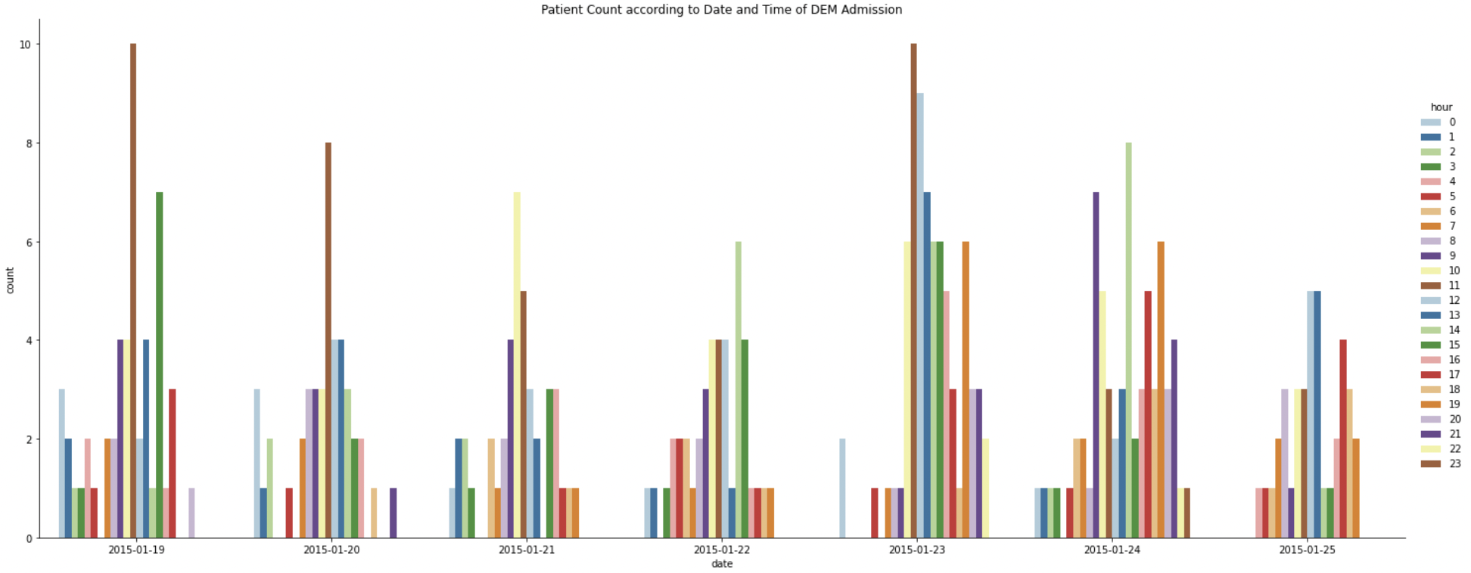
Areas to Renovate (to increase capacity)
Critical Care Intensive Treatment
Critical Care Area
Consultation Room
When to Renovate
Low P1 patient load
Low P2, P3 and P4
Low P3 and P4

Slide 14
Recommendations on Reducing Interruption
 | When to Renovate | Remarks
Critical Care Intensive Treatment | Wednesday, Saturday, Sunday | Low P1
Critical Care Area | Tuesday, Wednesday, Sunday | Low P2, P3 and P4
Consultation Room | Tuesday, Wednesday, Sunday | Low P3 and P4
Notes:
P2 - 7, 9, 7, 4, 10, 8, 14
P3 - 16, 11, 8, 11, 26, 21, 10
P4 - 20, 16, 9, 23, 29, 32, 8
Total (CCA) - 43, 36, 24, 38, 64, 61, 32
Total (Consultation Room) - 36, 27, 17, 34, 54, 53, 18

Slide 15
Thank you.

